Slide 1
NC FINAL PROJECT
k22-4225 (MUHAMMAD ISMAIL AWAN)
K22-4180 (AHAN ALI)
K22-4222 (AYAN EJAZ)

Slide 2
CODE
import numpy as np
import matplotlib.pyplot as plt
from mpl_toolkits.mplot3d import Axes3D
import pandas as pd
# Generate random data
x = np.random.rand(10, 1)
y = 2 * x + np.random.randn(10, 1)
# Define hypothesis function
def hypothesisFunc(theta, x):
return np.dot(x, theta)
# Define cost function
def costFunction(theta, x, y):
m = len(y)
h = hypothesisFunc(theta, x)
J = 1 / (2 * m) * np.sum((h - y) ** 2)
return J

Slide 3
# gradient descent function
def gradientDescent(x, y, theta, alpha, num_iterations, tol=1e-6):
m = len(y)
J_history = []
for _ in range(num_iterations):
h = hypothesisFunc(theta, x)
theta = theta - (alpha / m) * np.dot(x.T, (h - y))
J_history.append(costFunction(theta, x, y))
# Stopping criterion: Check if the change in cost is less than tolerance
if len(J_history) > 1 and abs(J_history[-1] - J_history[-2]) < tol:
break
return theta, J_history
# Add bias term to x
x = np.hstack((np.ones((x.shape[0], 1)), x))
theta = np.zeros((2, 1))
# Set hyperparameters
alpha = 0.01
num_iterations = 3000
theta_optimized, J_history = gradientDescent(x, y, theta, alpha, num_iterations)
print("Optimized theta:", theta_optimized)
print("Final cost:", J_history[-1])

Slide 4
# Plotting the cost function J(θ0, θ1) and generating a table with iteration data
# Plot of J(θ0, θ1) with initial point (2d)
theta0_initial = theta[0][0]
theta1_initial = theta[1][0]
theta0_values = np.linspace(-2, 2, 100)
theta1_values = np.linspace(-2, 2, 100)
theta0_grid, theta1_grid = np.meshgrid(theta0_values, theta1_values)
J_values = np.zeros_like(theta0_grid)
for i in range(len(theta0_values)):
for j in range(len(theta1_values)):
J_values[i, j] = costFunction(np.array([[theta0_values[i]], [theta1_values[j]]]), x, y)
plt.figure(figsize=(10, 5))
plt.subplot(1, 2, 1)
plt.contour(theta0_grid, theta1_grid, J_values, levels=50)
plt.xlabel('Theta0')
plt.ylabel('Theta1')
plt.title('Cost Function J(Theta0, Theta1)')
plt.colorbar(label='Cost')
plt.scatter(theta0_initial, theta1_initial, color='red', label='Initial Theta')
plt.legend()

Slide 5
# 3D plot of the cost function J(θ0, θ1)
theta0_values = np.linspace(-2, 2, 100)
theta1_values = np.linspace(-2, 2, 100)
theta0_grid, theta1_grid = np.meshgrid(theta0_values, theta1_values)
J_values = np.zeros_like(theta0_grid)
for i in range(len(theta0_values)):
for j in range(len(theta1_values)):
J_values[i, j] = costFunction(np.array([[theta0_values[i]], [theta1_values[j]]]), x, y)
fig = plt.figure(figsize=(10, 5))
ax = fig.add_subplot(111, projection='3d')
ax.plot_surface(theta0_grid, theta1_grid, J_values, cmap='viridis')
ax.set_xlabel('Theta0')
ax.set_ylabel('Theta1')
ax.set_zlabel('Cost')
ax.set_title('Cost Function J(Theta0, Theta1)')
plt.show()

Slide 6
# Table with J, θ0, and θ1 at each iteration
theta_optimized = np.zeros((2, 1))
theta_values = [theta.flatten().tolist()]
iteration_data = pd.DataFrame(columns=['Iteration', 'J', 'Theta0', 'Theta1'])
for i in range(num_iterations):
h = hypothesisFunc(theta_optimized, x)
J_iteration = costFunction(theta_optimized, x, y)
new_row = {'Iteration': i, 'J': J_iteration, 'Theta0': theta_optimized[0][0], 'Theta1': theta_optimized[1][0]}
iteration_data = pd.concat([iteration_data, pd.DataFrame([new_row])], ignore_index=True)
theta_values.append(theta_optimized.flatten().tolist())
theta_optimized, _ = gradientDescent(x, y, theta_optimized, alpha, 1)
plt.subplot(1, 2, 2)
plt.plot(iteration_data['Iteration'], iteration_data['J'])
plt.xlabel('Iteration')
plt.ylabel('Cost (J)')
plt.title('Cost vs. Iteration')
plt.scatter(iteration_data['Iteration'], iteration_data['J'], color='red', label='Updated (θ0, θ1)')
plt.legend()
plt.tight_layout()
plt.show()
print(iteration_data)

Slide 7
# Scatter plot of x and y with the line y = θ0 + θ1x
# Scatter plot of x and y
plt.scatter(x[:,1], y, label='Data Points')
# Calculate the y values for the line y = θ0 + θ1x
y_predicted = theta_optimized[0] + theta_optimized[1] * x[:,1]
# Plot the line
plt.plot(x[:,1], y_predicted, color='red', label='Fitted Line: y = {:.2f} + {:.2f}x'.format(theta_optimized[0][0], theta_optimized[1][0]))
plt.xlabel('x')
plt.ylabel('y')
plt.title('Scatter plot of x and y with Fitted Line')
plt.legend()
plt.show()

Slide 8
#for Convex functions (task A – part 4)
import numpy as np
import matplotlib.pyplot as plt
# Define a convex function: f(x) = x^2
def convex_function(x):
return x ** 2
# Define the non-convex function: f(x) = sin(x)
def non_convex_function(x):
return np.sin(x)
# Define tangent lines at specific points
def tangent_line_convex(x, x_point):
return 2 * x_point * (x - x_point) + convex_function(x_point)
def tangent_line_non_convex(x, x_point):
return np.cos(x_point) * (x - x_point) + non_convex_function(x_point)
x_values = np.linspace(-2, 2, 100)
y_convex = convex_function(x_values)
y_non_convex = non_convex_function(x_values)
# Choose points for tangent lines
x_point_convex = 1.5
x_point_non_convex = 1.5

Slide 9
# Calculate tangent lines
tangent_convex = tangent_line_convex(x_values, x_point_convex)
tangent_non_convex = tangent_line_non_convex(x_values, x_point_non_convex)
# Calculate chord lines
chord_convex = convex_function(x_values) + (x_values - x_point_convex) * (convex_function(2) - convex_function(x_point_convex)) / (2 - x_point_convex)
chord_non_convex = non_convex_function(x_values) + (x_values - x_point_non_convex) * (non_convex_function(2) - non_convex_function(x_point_non_convex)) / (2 - x_point_non_convex)
# Plotting
plt.figure(figsize=(12, 5))
plt.subplot(1, 2, 1)
plt.plot(x_values, y_convex, color='blue', label='Convex Function: $f(x) = x^2$')
plt.plot(x_values, tangent_convex, linestyle='--', color='orange', label='Tangent at $x=1.5$')
plt.plot(x_values, chord_convex, linestyle='-.', color='green', label='Chord between $(1.5, f(1.5))$ and $(2, f(2))$')
plt.xlabel('x')
plt.ylabel('f(x)')
plt.title('Convex Function')
plt.legend()

Slide 10
plt.subplot(1, 2, 2)
plt.plot(x_values, y_non_convex, color='red', label='Non-Convex Function: $f(x) = \sin(x)$')
plt.plot(x_values, tangent_non_convex, linestyle='--', color='orange', label='Tangent at $x=1.5$')
plt.plot(x_values, chord_non_convex, linestyle='-.', color='green', label='Chord between $(1.5, f(1.5))$ and $(2, f(2))$')
plt.xlabel('x')
plt.ylabel('f(x)')
plt.title('Non-Convex Function')
plt.legend()
plt.tight_layout()
plt.show()
----------------------------------------------------------------END------------------------------------------------------------------------

Slide 11
Title Of Research Paper : An Effective Optimization Method for Machine Learning Based on ADAM

Slide 12
Introduction
What is Machine Learning
Gradient Descent and Optimization Challenges
Introduction of ADAM and AdaMax Methods
Limitations of Existing Optimization Methods
Proposed Methodology

Slide 13
Cost Function
Definition of the Cost Function
A cost function measures the disparity between predicted and actual outcomes in a model, guiding parameter adjustments to minimize this disparity and enhance model performance. It serves as a crucial metric for optimization algorithms in machine learning.
Challenges of Cost Function Optimization
Challenges in optimizing the cost function stem from its non-convexity, resulting in the presence of multiple local minima, exacerbated by the deepening structure of artificial neural networks and the repeated application of activation functions, necessitating further detailed analysis for comprehensive understanding.
Ongoing Research and Future Directions
Ongoing research delves into non-convex cost function complexities in machine learning, addressing challenges of multiple local minima and evolving neural network structures. Future directions aim to refine optimization techniques for enhanced machine learning performance through comprehensive analyses.

Slide 14
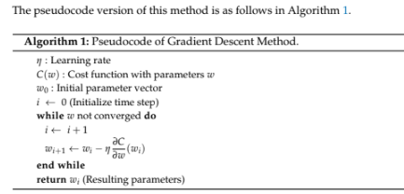
Learning Methods
GRADIENT DESCENT METHOD
Gradient descent is an optimization algorithm used to minimize the loss function in machine learning by iteratively adjusting the parameters of a model in the direction of the steepest descent of the gradient

Slide 15
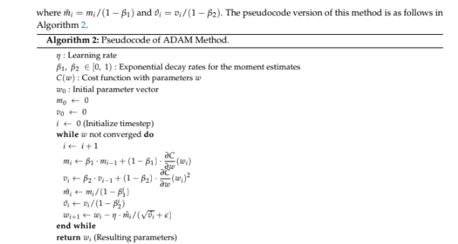
2 ) ADAM METHOD
ADAM is an optimization algorithm that combines the benefits of both momentum and
RMSprop. It adapts the learning rate for each parameter by calculating the first and second moments of the gradients.

Slide 16
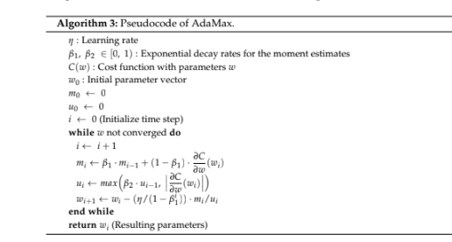
3 ) ADAMAX
ADAmax is a variant of the ADAM optimization algorithm that replaces the second moment
Estimation with the infinity norm of the gradients, offering improved convergence properties, particularly in deep learning models.

Slide 17
4) PROPOSED METHOD
We propose a new optimization method to address the challenges posed by increasing complexity in artificial neural networks and non-convex cost functions. Traditional gradient descent methods struggle with local minimums, prompting the need for a more efficient approach to optimize machine learning processes.
Utilizes a fixed-point iteration approach based on ADAM, considering the cost function's condition and its first derivative.
Introduces an auxiliary function H, determining its positive or negative value based on the initial sign of the cost function's derivative.
Demonstrates convergence through an iterative formula, ensuring stability and efficiency in optimization tasks.
Theoretical analysis confirms the method's effectiveness, showcasing its capability to approach the global minimum even with local minima present.
wi+1 = wi − η(m i /√vi + e),
where mi = β1mi−1 + (1 − β1)H(wi) and vi = β2vi−1 + (1 − β2)((H(wi))²),
enhancing efficiency and stability of optimization process. mi = mi/(1 − β1), and vi = vi/(1 − β2).

Slide 18
Numerical Tests
Numerical experiments compare the proposed method with traditional GD, ADAM, and AdaMax methods, where β1 and β2 in ADAM and AdaMax are fixed at 0.9 and 0.999, respectively, and ε is set to 10^-8 as default.
One Variable Non-Convex Function Test
Testing each method with a non-convex cost function (C(w)), where the proposed method settles at the global minimum beyond local minima, unlike GD, ADAM, and AdaMax, which remain trapped at local minima.

Slide 19
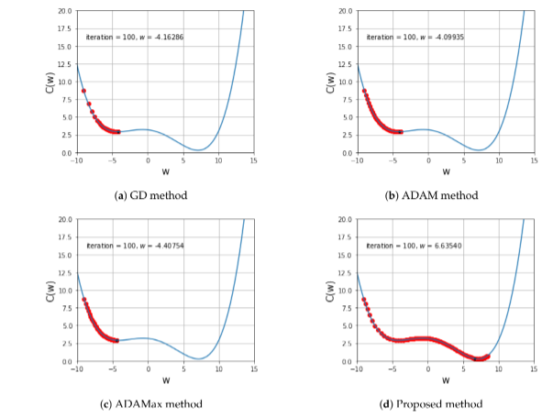

Slide 20
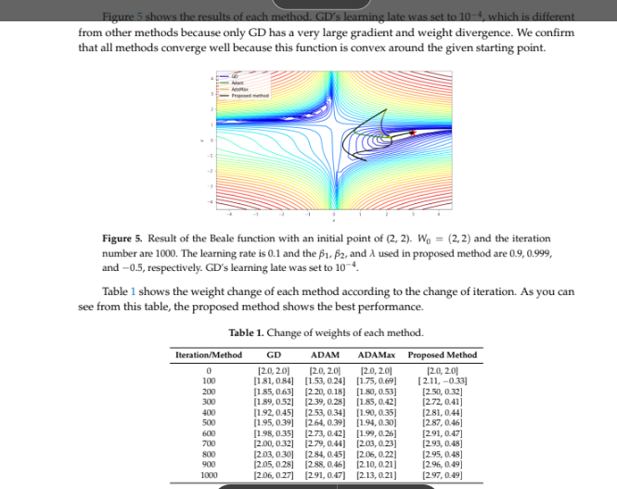
Two Variables Non-Convex Function Test This section conducts experiments on three two-variable cost functions, aiming to find
global minima for the Beale and Styblinski-Tang functions, and to test the effectiveness of the proposed
method at a saddle point.
1) Beale function

Slide 21
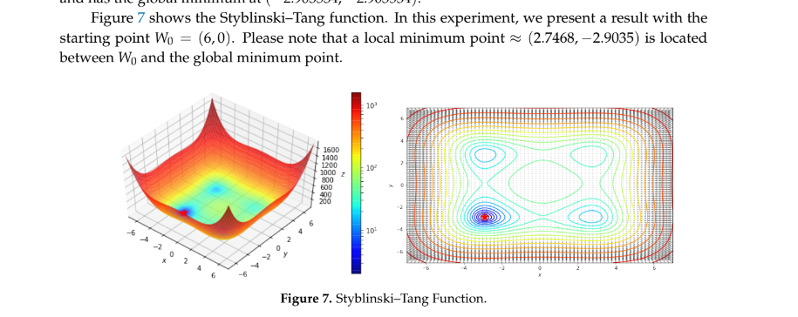
2) Styblinski–Tang function
We're studying the Styblinski-Tang function to find its lowest point at (-2.903534, -2.903534).
We start at the point (6, 0), but there's a local lowest point around (2.7468, -2.9035) on the way to the
global minimum.

Slide 22
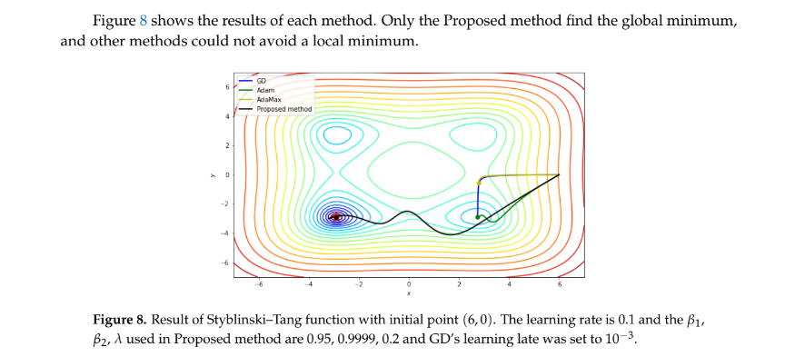

Slide 23
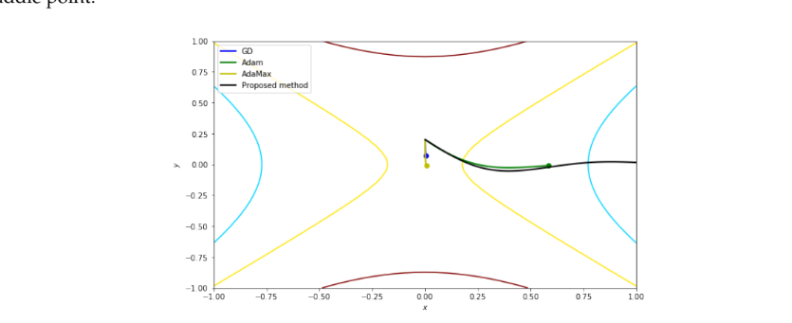
3) Function with a Saddle Point
The cost function 𝐶(𝑤1,𝑤2)=𝑤22−𝑤12+2C(w1​,w2​)=w22​−w12​+2 exhibits a saddle point at
(0, 0),. Results from two starting points, including
𝑊0=(0.001,0.2)W0​=(0.001,0.2),, highlighting the proposed method's rapid parameter changes near the saddle point

Slide 24
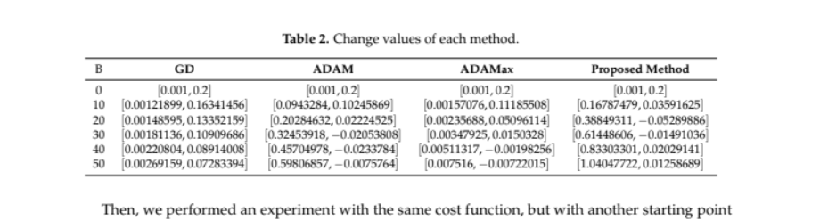

Slide 25
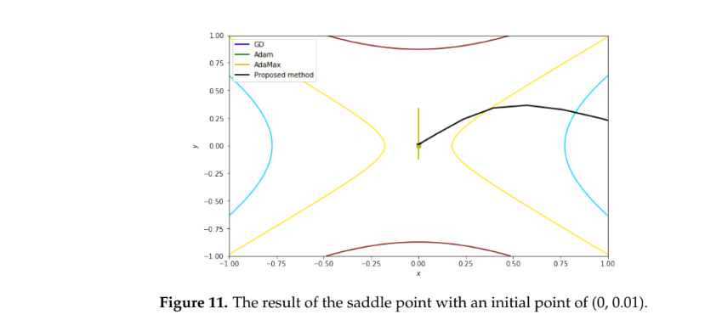

Slide 26
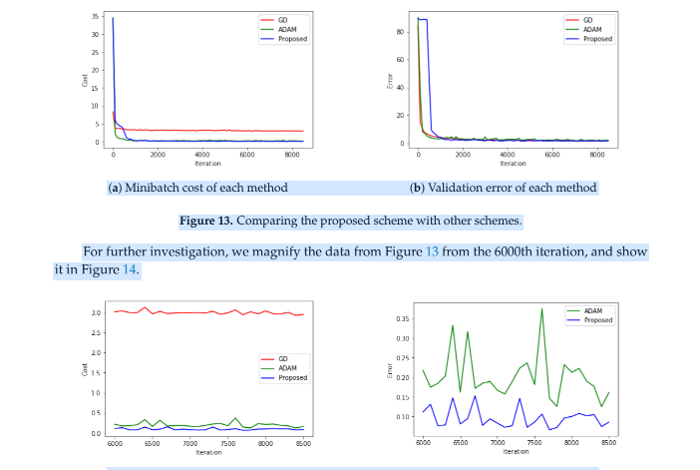
MNIST with CNN
Moving from basic ANN to CNN experiments, we tackle the complexity of adding more layers in ANN.
We test method performance using TensorFlow on the MNIST problem, observing reduced cost and error
over 8600 iterations. Further scrutiny from the 6000th iteration indicates the proposed method's advantage over ADAM, especially in image classification.

Slide 27
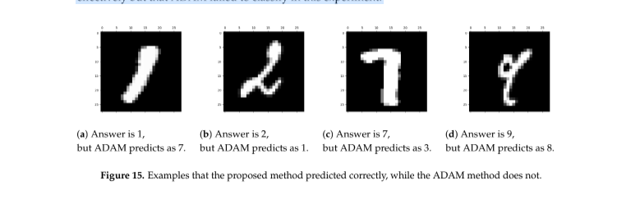

Slide 28
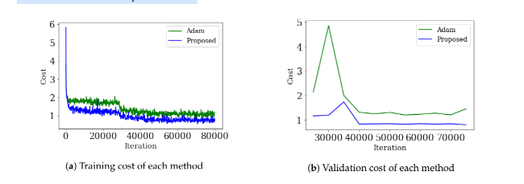
CIFAR-10 with RESNET
In previous section, we show that our method works better than ADAM in CNNs with the MNIST
dataset. We then test it on CIFAR10, a larger dataset with colorful images. Using the RESNET
architecture, known for its effectiveness, we see improved results compared to ADAM, proving our method's effectiveness for complex networks.

Slide 29
Conclusion
This paper introduces a new optimization method based on ADAM.
Our method outperforms existing methods by efficiently locating the global minimum.
Tested solely on image datasets like MNIST
The proposed method exhibits superior performance even when faced with local minima near the starting point.
Further experiments are planned to assess its effectiveness across various models, including RNNs for time series prediction and NLP models.

